Slide 1
iDot2, Alliances 1879-1914
By the time of the First World War, the major powers of Europe had formed two alliance blocks. The Triple Alliance of Germany, Austria-Hungary, and Italy formed one while the Triple Entente of Russia, France, and Great Britain formed the other. These alliances did not interfere with trade relationships and they were always understood as ways to deter war rather than start war. Once the July crisis of 1914 began, the alliances ensured that most of the great powers would become involved, but the alliances had been in place for decades. What role did they play in causing the war?

Slide 2
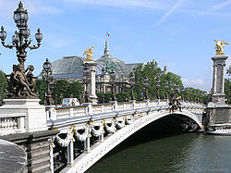
The Franco –Russian Alliance Military Convention- August 18 1892
France and Russia, being animated by a common desire to preserve peace, and having no other object than to meet the necessities of a defensive war, provoked by an attack of the forces of the Triple Alliance against either of them, have agreed upon the following provisions:
1. If France is attacked by Germany, or by Italy supported by Germany, Russia shall employ all her available forces to attack Germany.
If Russia is attacked by Germany, or by Austria supported by Germany, France shall employ all her available forces to attack Germany.
2. In case the forces of the Triple Alliance, or of any one of the Powers belonging to it, should be mobilized, France and Russia, at the first news of this event and without previous agreement being necessary, shall mobilize immediately and simultaneously the whole of their forces, and shall transport them as far as possible to their frontiers
Full text at: http://avalon.law.yale.edu/19th_century/frrumil.asp
Paris’s exquisite Alexander III bridge, built from 1896 to 1900 to flatter the Russians. It is named for Czar Nicholas II’s father. The French invited Nicholas to lay the cornerstone.

Slide 3
Anglo-Japanese Alliance (1902)
The Anglo-Japanese Treaty of Alliance in 1902 highlights the importance Britain gave to maintaining a sphere of influence in Asia.
‘our interests in China are so great, our proportion of the trade is so enormous and the potentialities of that trade are so gigantic that I feel no more vital question has ever been presented …’.
Joseph Chamberlain
The alliance agreed that if either country became involved in a war with another country, the contracting party (Japan or Britain) would remain neutral, but if Japan or Britain was attacked by two enemies, assistance would be given.
In order to safeguard British colonial interests in China in light of the emergence of Japanese imperialism, Russian interests in Manchuria and Koreas, Britain made a firm alliance with Japan, who themselves were nervous about Russian’s Asian foreign policy and ambitions.
This first agreement ended the British Foreign policy of “splendid isolation” and entangling alliances.
The agreement also gave Japan and ally (the British) as they sought to gain territory in Korea and Manchuria. Areas that were also prized by Russia.
The alliance was the first ever signed on equal terms between an Asian and European power. Japan thus took great pride in it.

Slide 4

Anglo-French Entente, 1904
The Entente Cordial resulted in a series of agreements between Britain and France designed to solve Anglo-French rivalry disputes over Siam, Madagascar, the New Hebrides, Newfoundland fishing areas and central and west Africa.
The 1904 “Declaration Respecting Egypt and Morocco” made Egypt a British sphere of influence and Morocco a French sphere of Influence.
The agreements did not promise any commitments of military support or aid in light of war against other counties. It was not a military alliance on paper, though in practice the French navy patrolled the Mediterranean sea, the British navy the North sea with each one watching over each other’s interests.
The agreements were designed to settle past colonial disputes and increase understanding between France and Britain. The word “Germany” never appeared.
“Toward Universal Peace”

Slide 5
The Anglo-Russian Entente (1907)
Her Majesty the King of the United Kingdom…and His Majesty the Emperor of All the Russias, animated by the sincere desire to settle by mutual agreement different questions concerning the interests of their States on the Continent of Asia, have determined to conclude Agreements destined to prevent all cause of misunderstanding between Great Britain and Russia.
Preamble of Anglo- Russian Entente. The full text is at http://avalon.law.yale.edu/20th_century/angrusen.asp
Following the 1904 Entente Cordiale Between France and Britain in 1904, Britain made a similar entente (understanding) with Russia, France’s ally. As with the Entente Cordiale with France, no firm commitments were given with regard to military support and alliances. The Anglo-Russian Agreement’s primary purpose was to settle previous differences over spheres of influence in Afghanistan, Tibet and Persia.

Slide 6
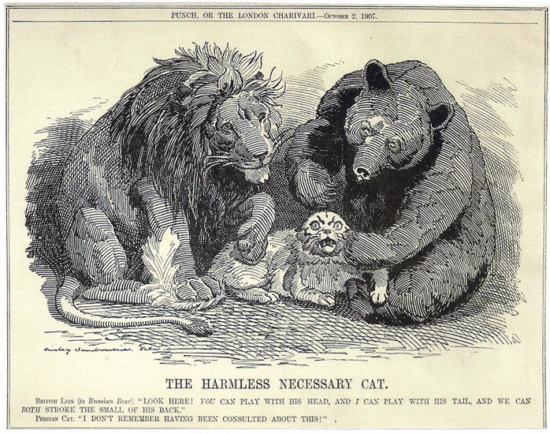
This cartoon shows a British lion and a Russian bear stroking a defenseless Persian cat. It demonstrates that the Anglo-Russian Entente originally had far more to do with dividing up Persia than with preparing for war against Germany.

Slide 7
Dual Alliance, 1879
The Dual Alliance of 1879 between Germany and Austria was designed as a secret defensive move against a perceived Russian threat:
“Should, contrary to their hope, and against the loyal desire of the two High Contracting parties, One of the two Empires be attacked by Russia, the High Contracting Parties are bound to come to the assistance one of the other with the whole war strength of their Empires.”
Just two decades earlier, Germany and Austria had gone to war. Now they were allies, proving that even old enemies could find common ground and the diplomatic map of Europe was subject to major shifts.
Following Russia’s attack on the Ottoman Empire in 1877, both countries sought greater security. While wanting to preserve their understanding with Russia and keep the peace between Russia and Austria, German leaders grew worried that Russia policies toward the Ottoman Empire and Balkans were a threat to peace. In 1879 Bismarck wrote to King Ludwig II of Bavaria:
“I cannot resist the conclusion that in the future, perhaps even in the near future, the peace is threatened by Russia and Russia alone.”

Slide 8
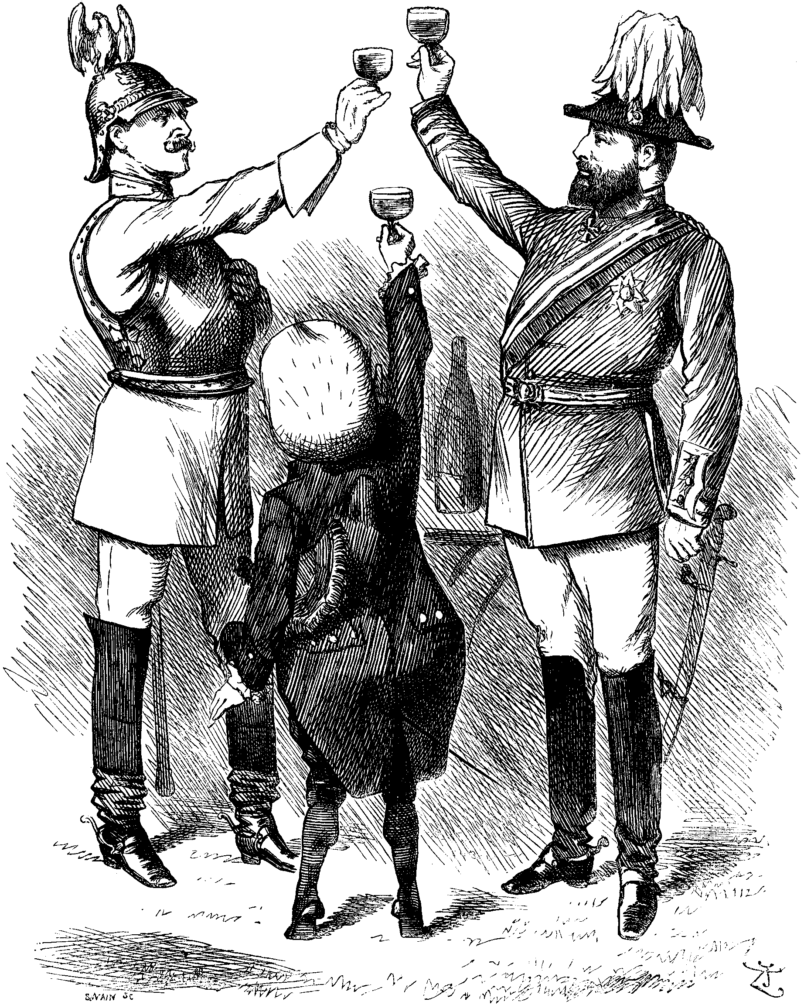
Triple Alliance 1882
Germany and Austria Hungary
promised that:
“In case Italy, without direct provocation on her part, should be attacked by France for any reason whatsoever, the two other Contracting Parities shall be bound to help and assistance with all their forces. . . . This same obligation shall devolve upon Italy in case of any aggression without direct provocation by France against Germany”
Italy had no obligation to go to war against England if England provoked the alliance.
The Triple Alliance showed that past rivals (like Italy and Austria-Hungary) could come together. In this cartoon, Italy is the small power trying to reach up to its new partners.

Slide 9
